Slide 1

WAY TO ENTERPRISE
Advanced Java
VTI ACADEMY
Author: duy.nguyenngoc1@vti.com.vn
March 2020

Slide 2
Agenda
Inheritance
HQL
SQL
Criteria
Assignments
Copyright © VTI Academy All Rights Reserved

Slide 3
Inheritance
4 types
Single Table
Table Per class
Joined
MappedSuperclass

Slide 4
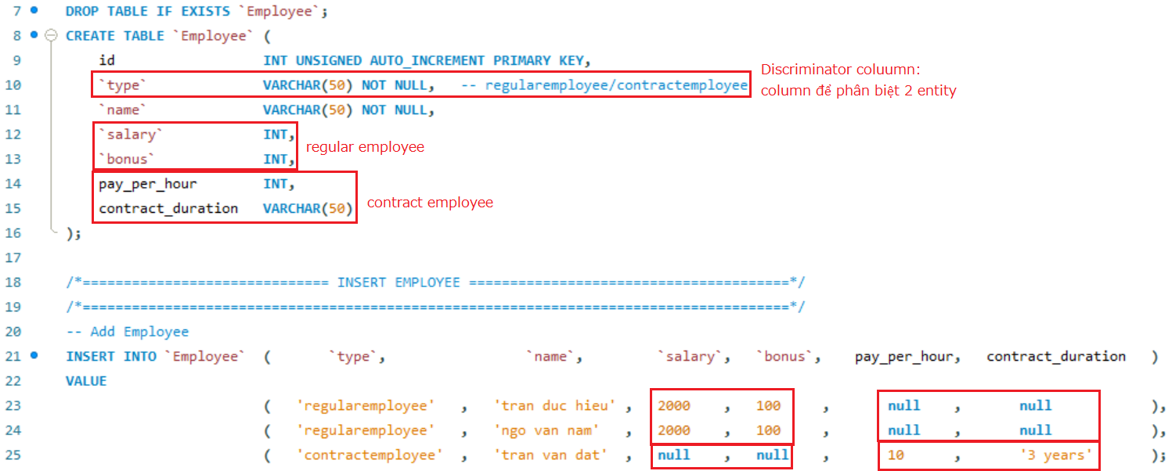
Inheritance
Single Table

Slide 5
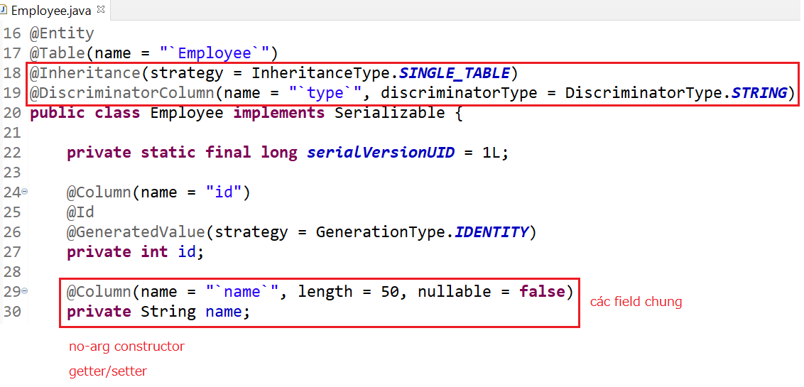
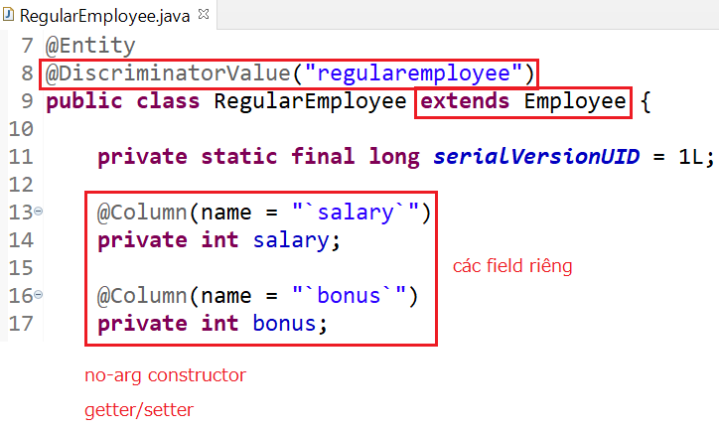
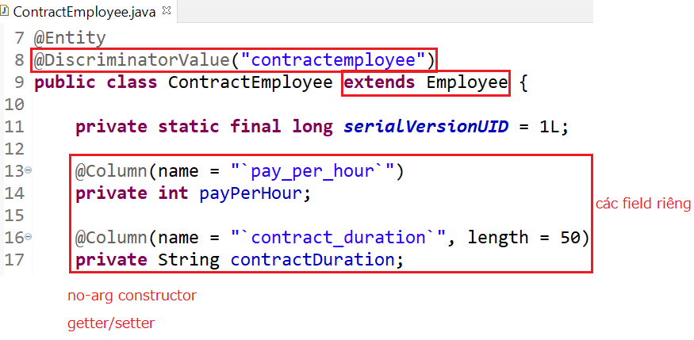
Inheritance

Slide 6
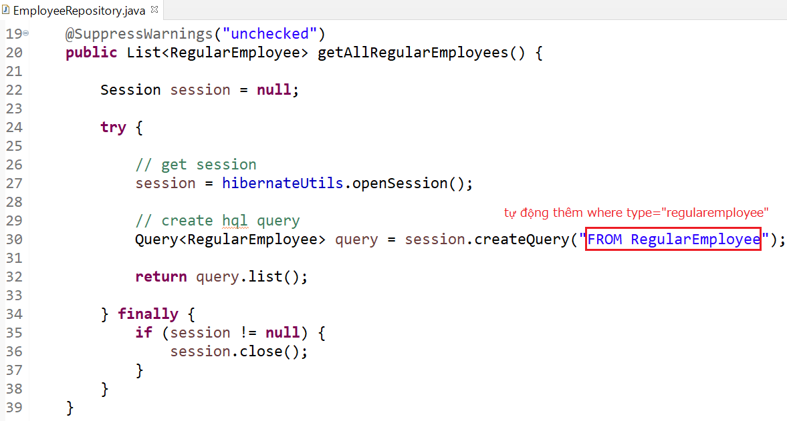
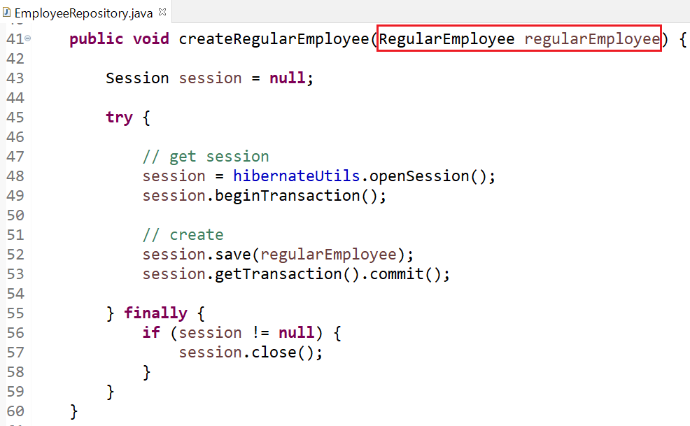
Inheritance
Repository

Slide 7
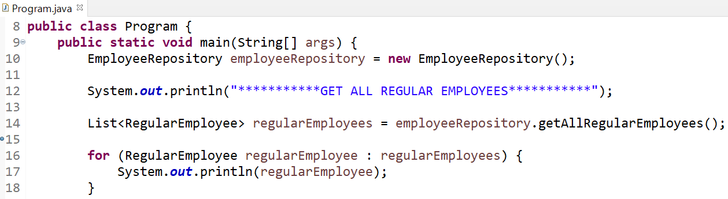
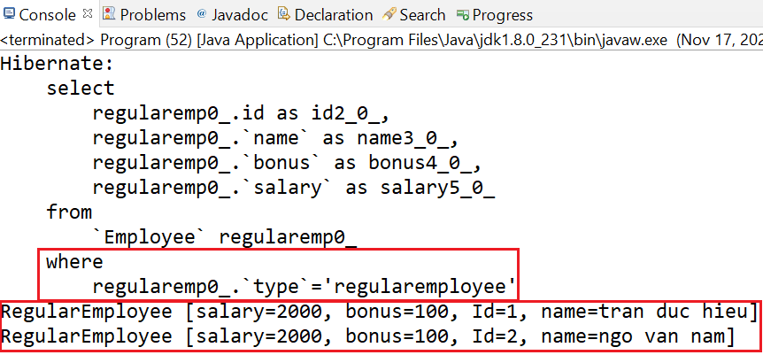
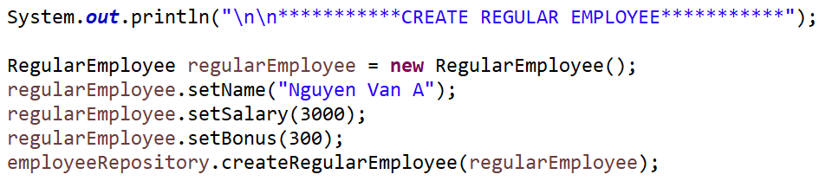
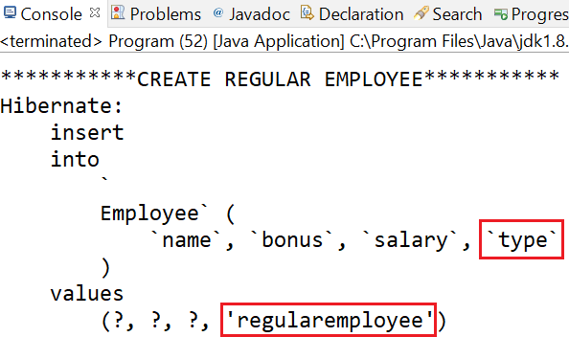
Inheritance

Slide 8
Inheritance
Advantages
Simple Implement
There is only 1 table in the database
Performance is better because there is no need to join or do subquery
Disadvantages
Not configurable Not Null
Table is not normalized

Slide 9
Testing System Assignment
Self-practice

Slide 10
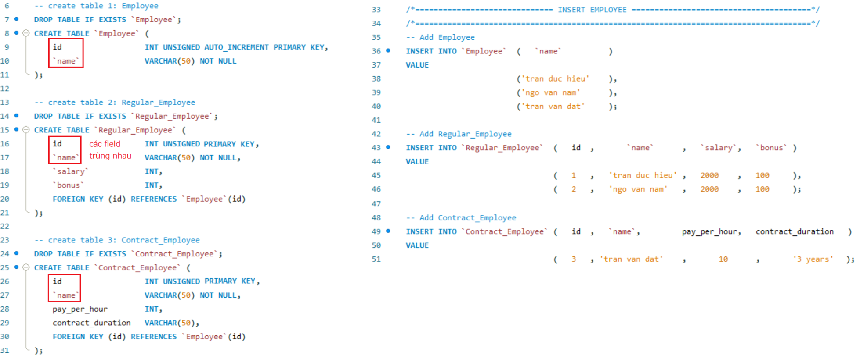
Inheritance
Table per class (Not Recommended)

Slide 11
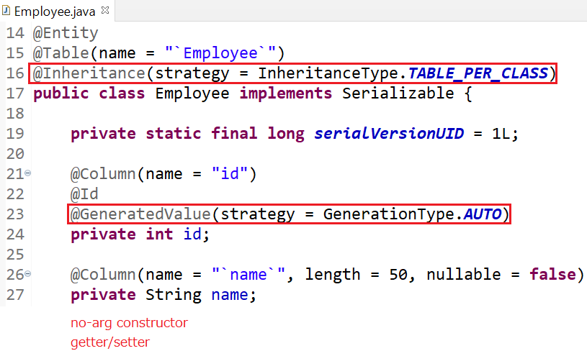
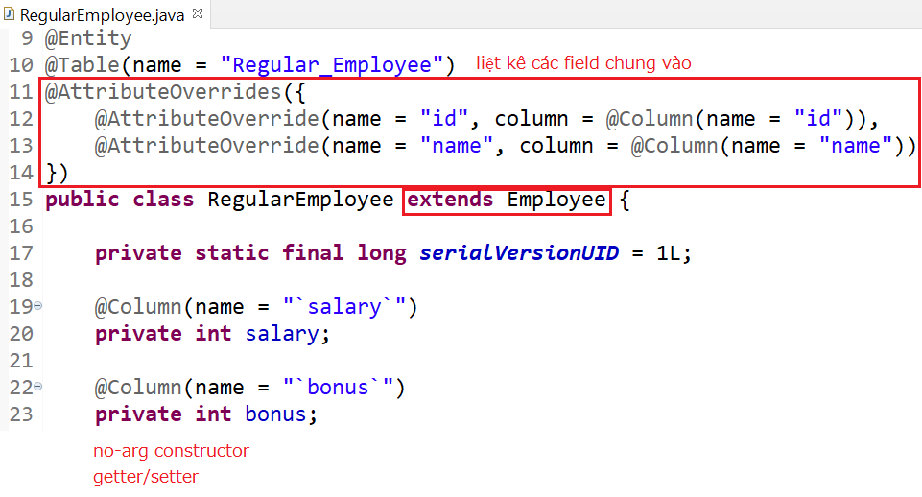
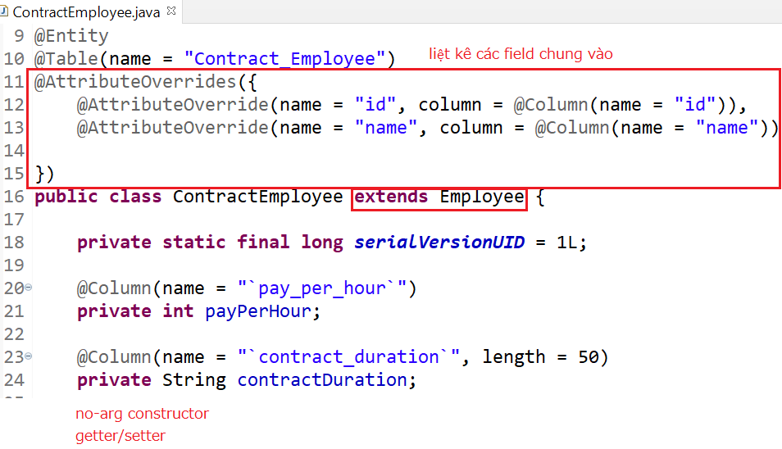
Inheritance

Slide 12
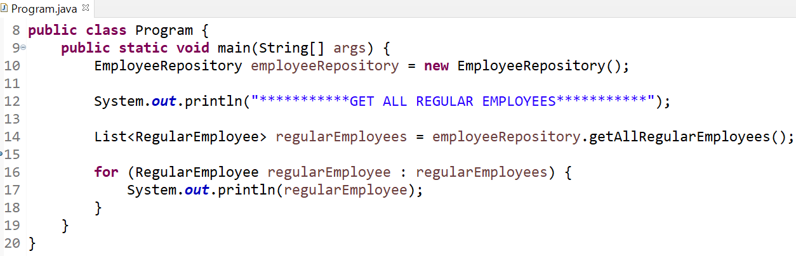
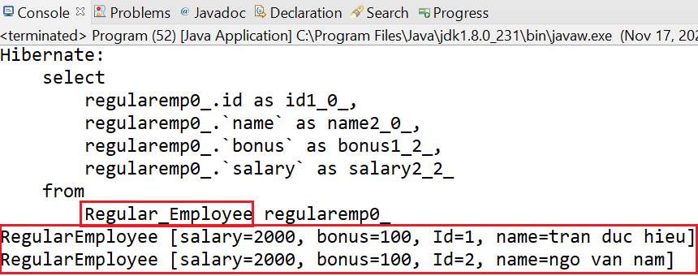
Inheritance

Slide 13
Inheritance
Advantages
Can set NOT NULL
Disadvantages
Table is not normalized
Duplicated data
Lower performance (due to additional UNION operators)

Slide 14
Testing System Assignment
Self-practice

Slide 15
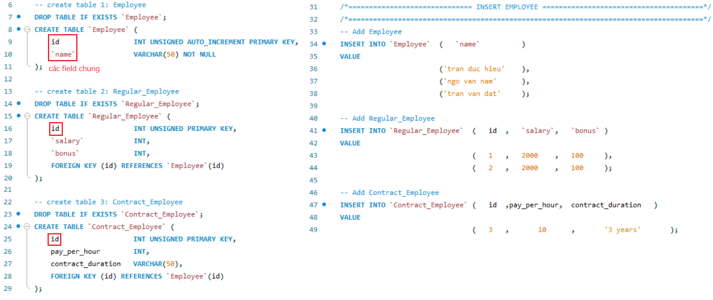
Inheritance
Joined

Slide 16
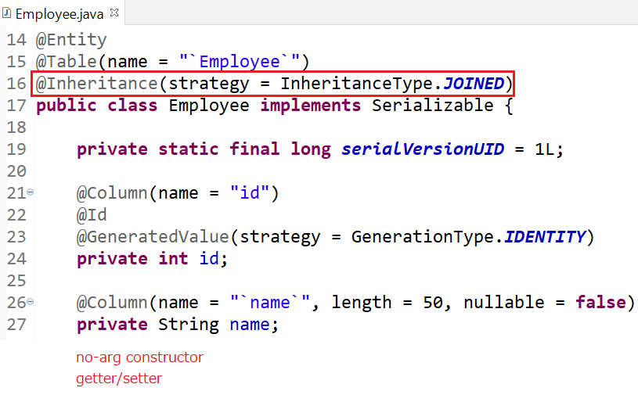
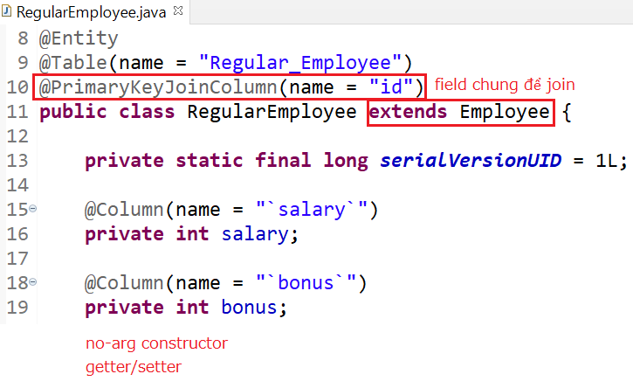
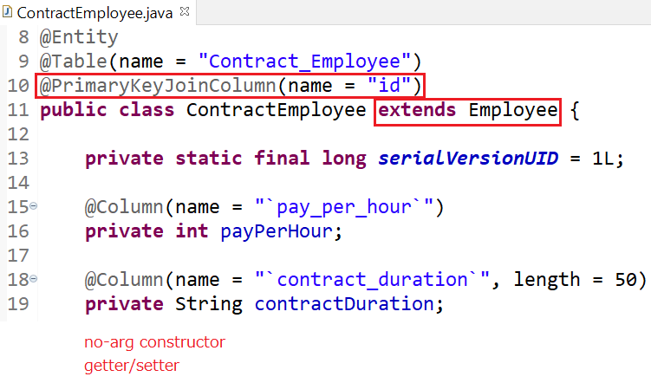
Inheritance

Slide 17
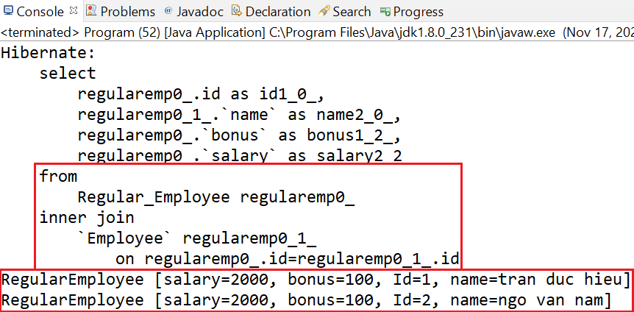
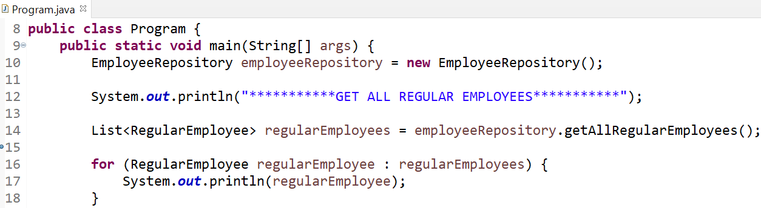
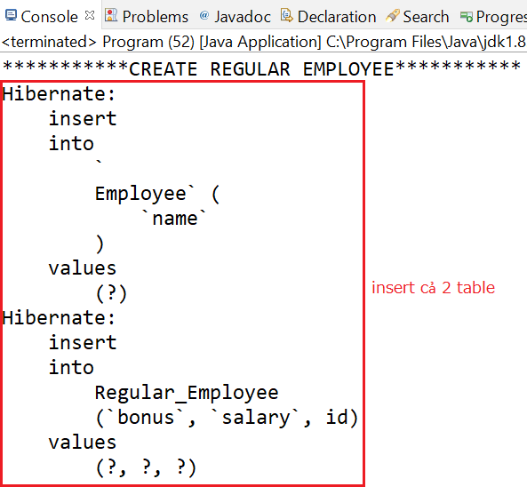
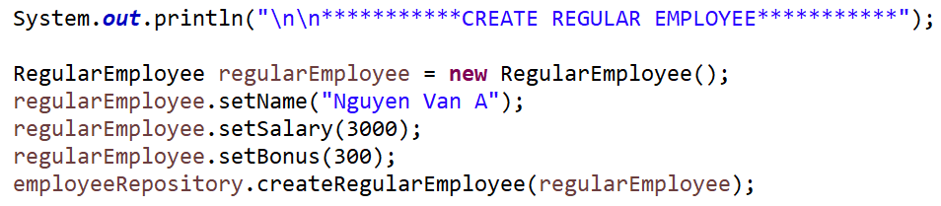
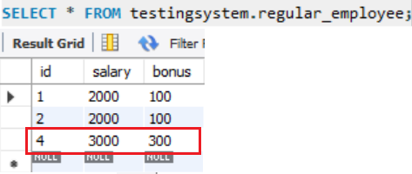
Inheritance

Slide 18
Inheritance
Advantages
Tables are normalized
Data is not duplicated
Can set NOT NULL
Disadvantages
Low performance (due to having to Join related child classes in the query)

Slide 19
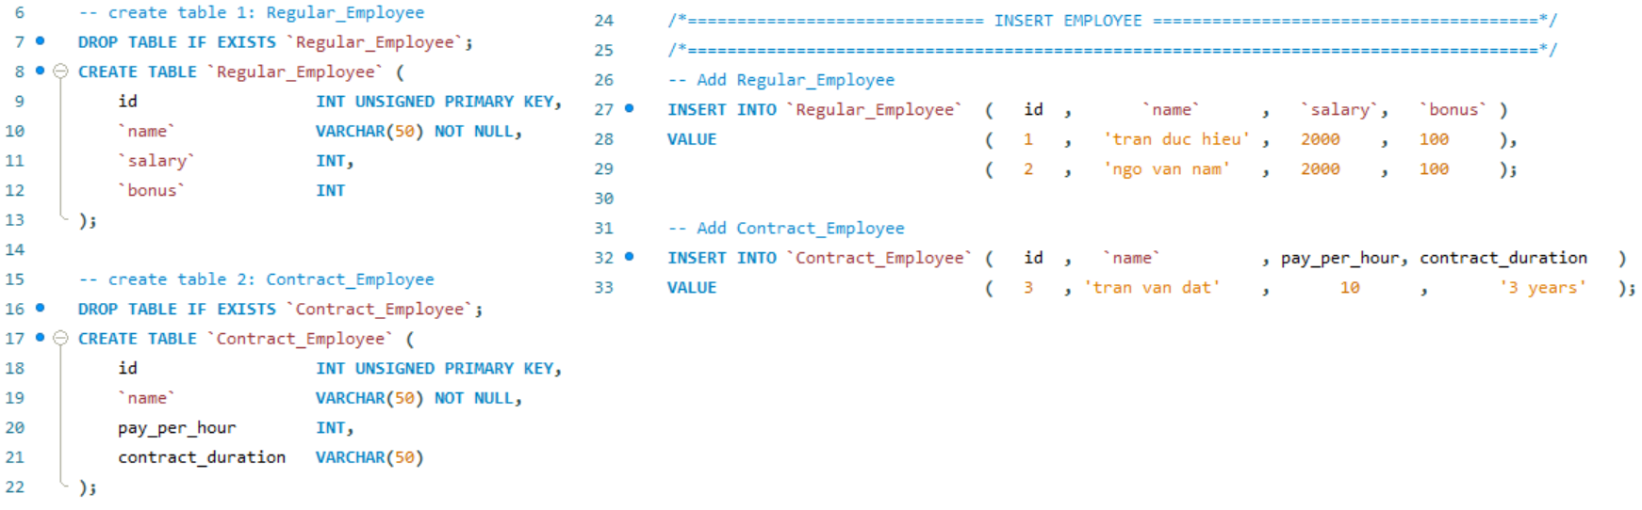
Inheritance
MappedSuperclass

Slide 20
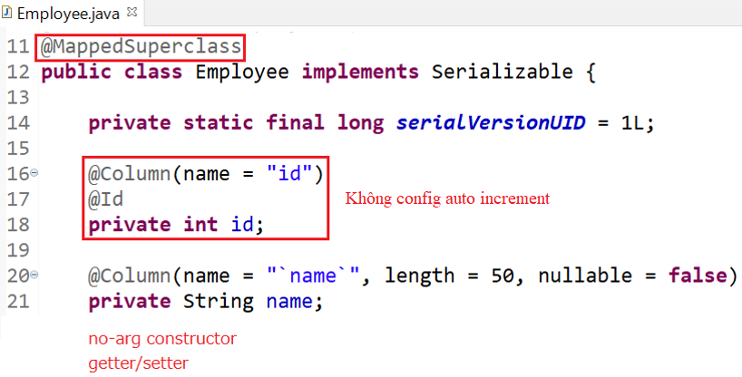
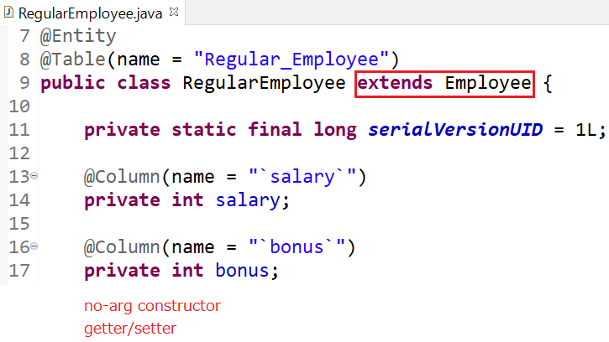
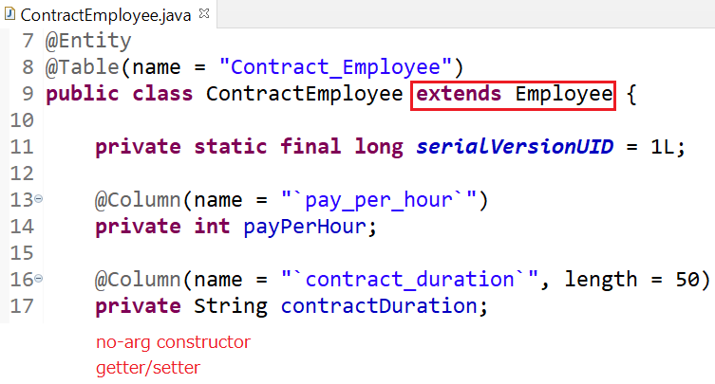
Inheritance

Slide 21
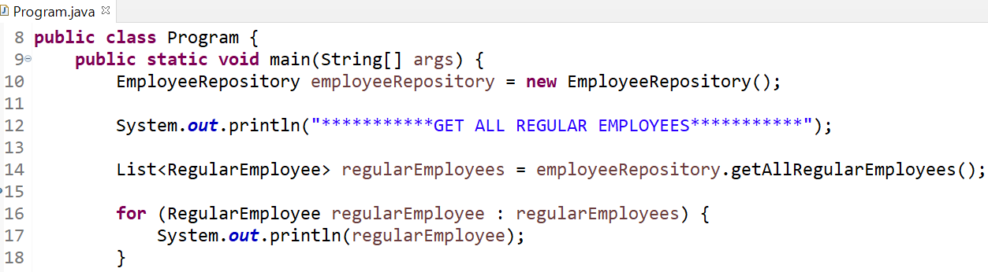
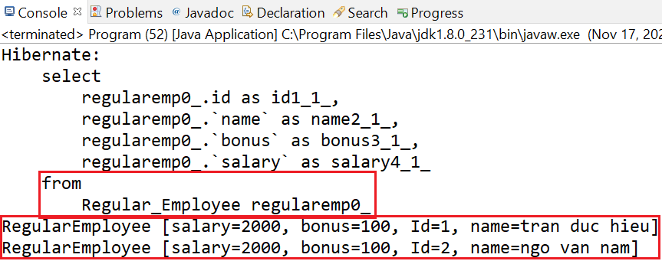
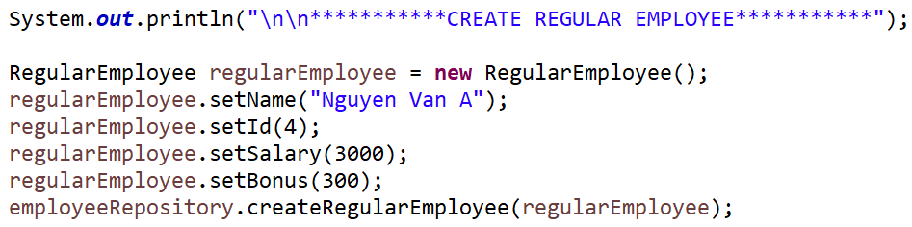
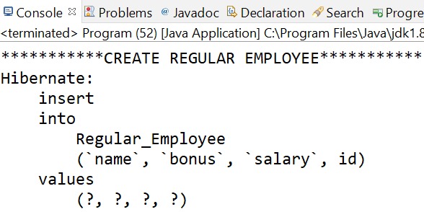
Inheritance

Slide 22
Testing System Assignment
Self-practice

Slide 23
Query
HQL (Recommended)
SQL
Criteria

Slide 24
HQL
Stands for Hibernate Query Language
HQL will be translate to SQL (JDBC)
HQL should be used whenever possible to avoid complex changes in database and take advantage of Hibernate
Keywords like SELECT, FROM, WHERE, ... are not case-sensitive, but attributes like table names, column names in HQL are case-sensitive.
Working with Java Variable, Java Object, Java Constructor, ..., Java

Slide 25

HQL
Select
AS
Distinct
WHERE

Slide 26
HQL
ORDER BY
NULLS FIRST & NULLS LAST
min(), max(), sum(), avg(), count(*), count(1), count(field)
LIMIT & OFFSET
GROUP BY

Slide 27
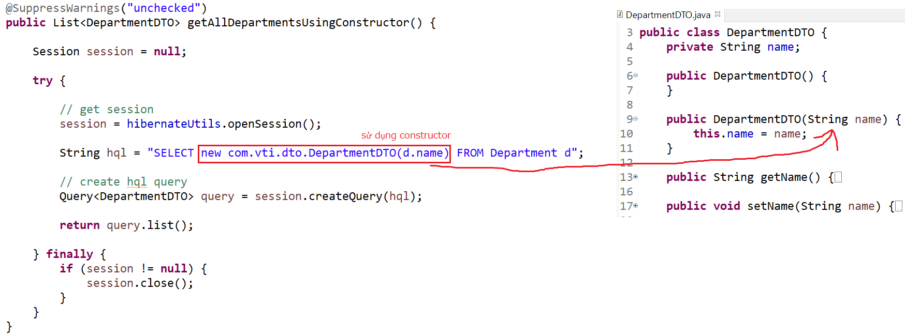
HQL
Using Constructor

Slide 28
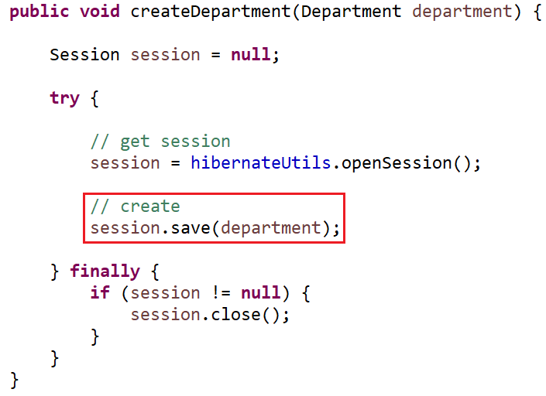
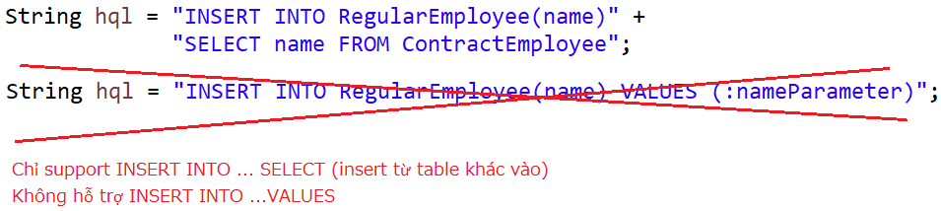
HQL
Insert
Not support INSERT INTO ...VALUES ...
Only Support INSERT INTO ... SELECT ...

Slide 29
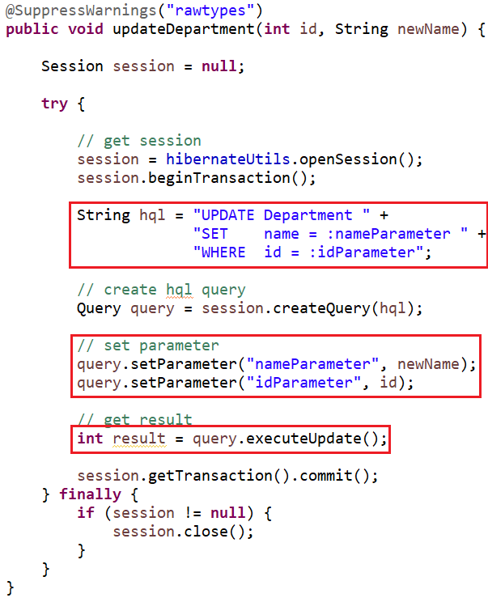
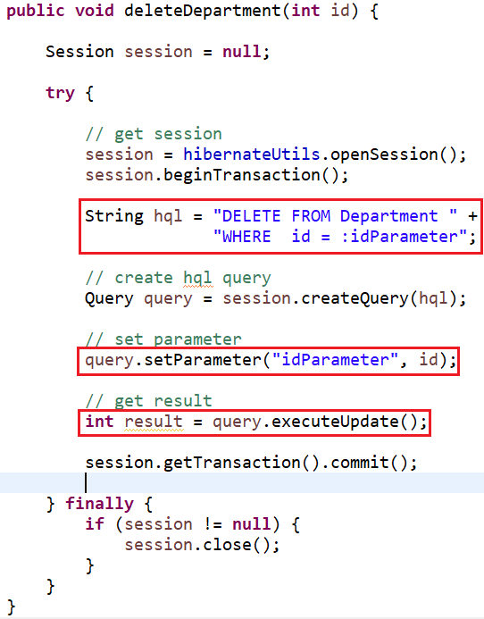
HQL
Update
Delete

Slide 30
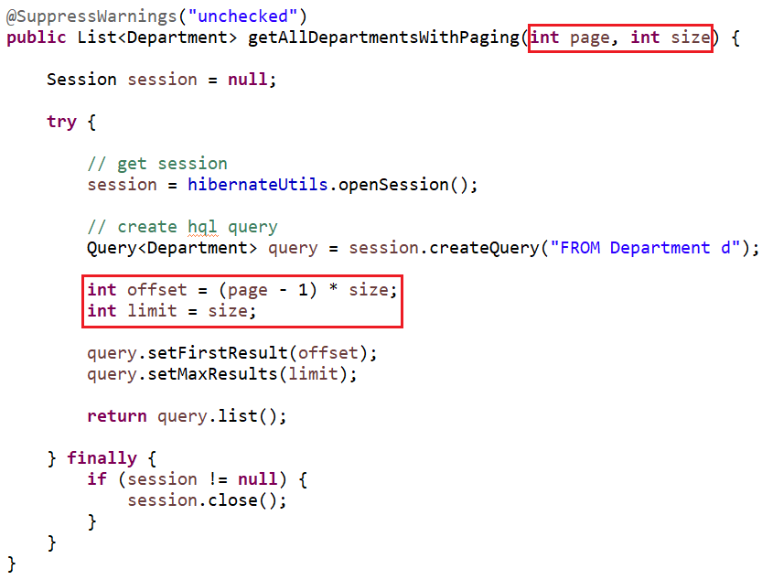
HQL
Paging

Slide 31
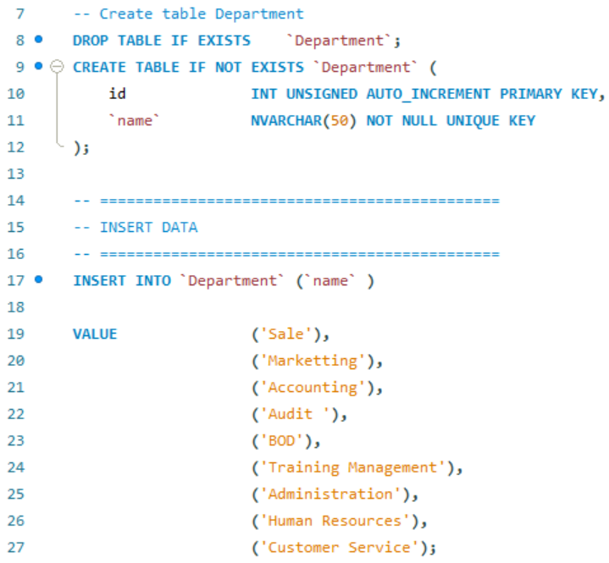
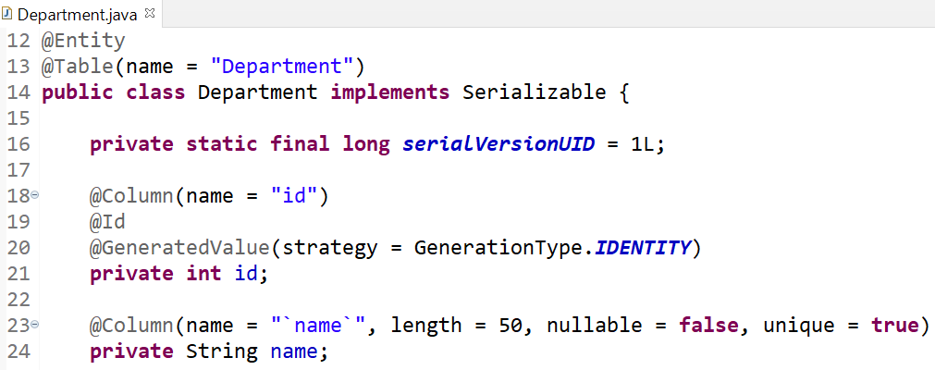
HQL
Example:

Slide 32
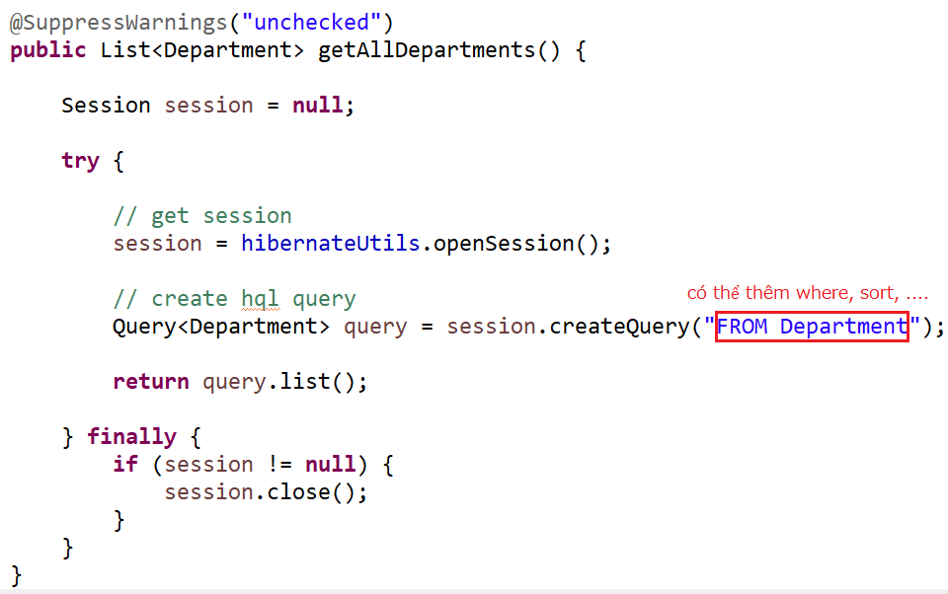
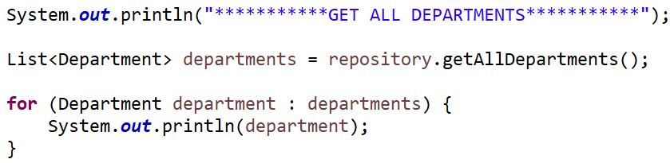
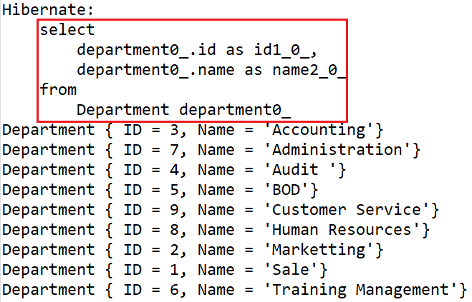
HQL
Select

Slide 33
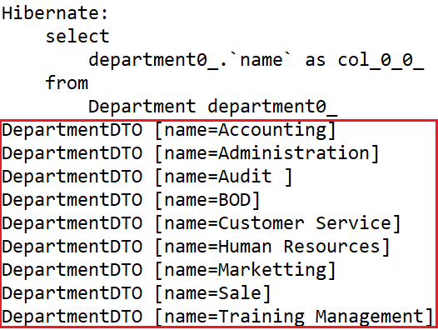
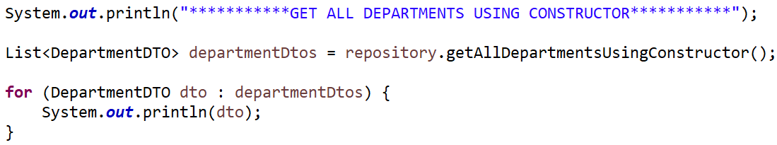
HQL
Select with constructor

Slide 34
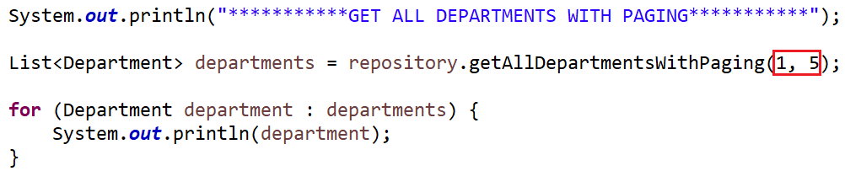
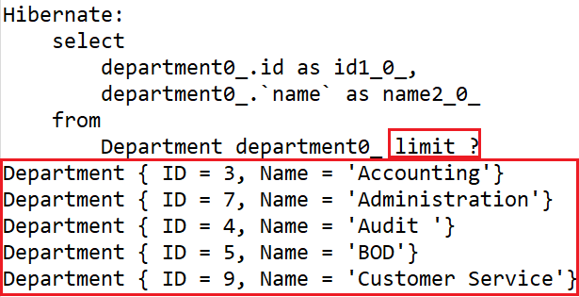
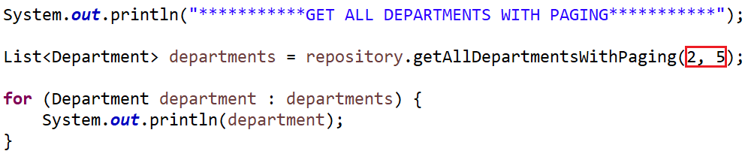
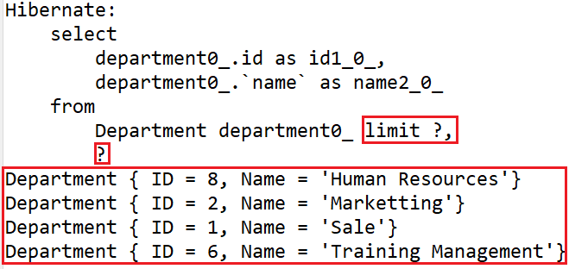
HQL
Paging

Slide 35



HQL
Count

Slide 36



HQL
Set parameter

Slide 37


HQL
Update

Slide 38

HQL
Delete

Slide 39
Testing System Assignment
Self-practice

Slide 40


HQL
Transaction

Slide 41
HQL
Default autocommit = false ➔ Using transaction for Insert, Update, Delete
https://stackoverflow.com/questions/23100888/why-is-hibernate-connection-autocommit-true-not-recommended-in-hibernate?fbclid=IwAR3pJld-6l4YZbs1_S4J41S4w5Bfs-UNo0HffHwBrhHKv5sydXAcaPAVtJ0
https://developer.jboss.org/wiki/Non-transactionalDataAccessAndTheAuto-commitMode?fbclid=IwAR0rbo810sTb_gRfx95NSTbAFtk4hG7hX5NFB-0BzegEBOvWRLPEXfriWQc
<property name="connection.autocommit">true</property>

Slide 42
SQL
Using for Native SQL Query
Working with SQL Field, SQL Table, ..., SQL
Call procedure
Call function

Slide 43


SQL
Example:

Slide 44
Testing System Assignment
Self-practice

Slide 45
Criteria
Allows building SQL statements based on objects
Using HQL
Components
Restriction (Where)
Projection
Order By
Paging

Slide 46


Criteria
Select
SELECT * FROM Employee
Where (Restriction)
And, Or

Slide 47



Criteria
Projection (Aggregation)
Order By
NULLS FIRST & NULLS LAST
Paging

Slide 48



Criteria
Example

Slide 49
Testing System Assignment
Self-practice

Slide 50

Testing System Assignments

Slide 51

Demo
Demo Generate entity Using JPA tools
View on drive

Slide 52
Reference
https://www.javatpoint.com/hibernate-tutorial
https://www.baeldung.com/

Slide 53
Q & A
Copyright © VTI Academy All Rights Reserved

